Slide 1

SOFTWARE ENGINEERING
By
R.Vignesh,M.E(Ph.D)
Assistant Professor

Slide 2

SYLLABUS

Slide 3
Design Process
Software design is a mechanism to transform user requirements into some suitable form, which helps the programmer in software coding and implementation.
It deals with representing the client's requirement, as described in SRS (Software Requirement Specification) document, into a form, i.e., easily implementable using programming language.
The software design phase is the first step in SDLC (Software Design Life Cycle), which moves the concentration from the problem domain to the solution domain.
In software design, we consider the system to be a set of components or modules with clearly defined behaviors & boundaries.

Slide 4
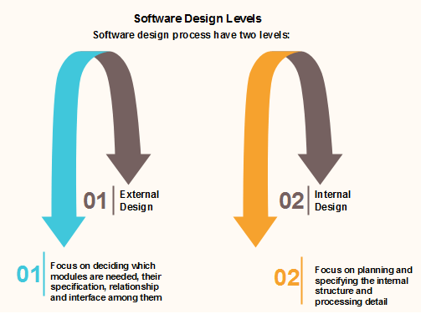

Slide 5
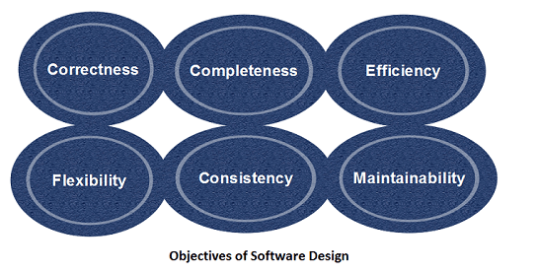
Objectives of Software Design
Following are the purposes of Software design:

Slide 6
Correctness:Software design should be correct as per requirement.
Completeness:The design should have all components like data structures, modules, and external interfaces, etc.
Efficiency:Resources should be used efficiently by the program.
Flexibility:Able to modify on changing needs.
Consistency:There should not be any inconsistency in the design.
Maintainability: The design should be so simple so that it can be easily maintainable by other designers

Slide 7
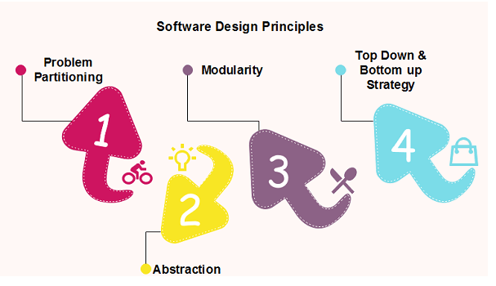
Software Design Principles
Software design principles are concerned with providing means to handle the complexity of the design process effectively.
Effectively managing the complexity will not only reduce the effort needed for design but can also reduce the scope of introducing errors during design.

Slide 8
Problem Partitioning:
For small problem, we can handle the entire problem at once but for the significant problem, divide the problems and conquer the problem it means to divide the problem into smaller pieces so that each piece can be captured separately.
For software design, the goal is to divide the problem into manageable pieces.
Benefits of Problem Partitioning:
Software is easy to understand
Software becomes simple
Software is easy to test
Software is easy to modify
Software is easy to maintain
Software is easy to expand

Slide 9
These pieces cannot be entirely independent of each other as they together form the system.
They have to cooperate and communicate to solve the problem. This communication adds complexity.
Abstraction
An abstraction is a tool that enables a designer to consider a component at an abstract level without bothering about the internal details of the implementation.
Abstraction can be used for existing element as well as the component being designed.
Here, there are two common abstraction mechanisms

Slide 10
Functional Abstraction
Data Abstraction
Functional Abstraction
A module is specified by the method it performs.
The details of the algorithm to accomplish the functions are not visible to the user of the function.
Functional abstraction forms the basis for Function oriented design approaches.
Data Abstraction
Details of the data elements are not visible to the users of data. Data Abstraction forms the basis for Object Oriented design approaches.

Slide 11
Modular Design
Modularity
Modularity specifies to the division of software into separate modules which are differently named and addressed and are integrated later on in to obtain the completely functional software.
It is the only property that allows a program to be intellectually manageable.
Single large programs are difficult to understand and read due to a large number of reference variables, control paths, global variables, etc.
The desirable properties of a modular system are:
Each module is a well-defined system that can be used with other applications.
Each module has single specified objectives.
Modules can be separately compiled and saved in the library.
Modules should be easier to use than to build.
Modules are simpler from outside than inside.

Slide 12
Advantages of Modularity
There are several advantages of Modularity
It allows large programs to be written by several or different people
It encourages the creation of commonly used routines to be placed in the library and used by other programs.
It simplifies the overlay procedure of loading a large program into main storage.
It provides more checkpoints to measure progress.
It provides a framework for complete testing, more accessible to test
It produced the well designed and more readable program.

Slide 13
Disadvantages of Modularity
There are several disadvantages of Modularity
Execution time maybe, but not certainly, longer
Storage size perhaps, but is not certainly, increased
Compilation and loading time may be longer
Inter-module communication problems may be increased
More linkage required, run-time may be longer, more source lines must be written, and more documentation has to be done

Slide 14
Modular Design
Modular design reduces the design complexity and results in easier and faster implementation by allowing parallel development of various parts of a system.
We discuss a different section of modular design in detail in this section:
Functional Independence:
Functional independence is achieved by developing functions that perform only one kind of task and do not excessively interact with other modules.
Independence is important because it makes implementation more accessible and faster.
The independent modules are easier to maintain, test, and reduce error propagation and can be reused in other programs as well.
Thus, functional independence is a good design feature which ensures software quality.

Slide 15
It is measured using two criteria:
Cohesion: It measures the relative function strength of a module.
Coupling: It measures the relative interdependence among modules.
Information hiding:
The fundamental of Information hiding suggests that modules can be characterized by the design decisions that protect from the others, i.e., In other words, modules should be specified that data include within a module is inaccessible to other modules that do not need for such information
The use of information hiding as design criteria for modular system provides the most significant benefits when modifications are required during testing's and later during software maintenance.
This is because as most data and procedures are hidden from other parts of the software, inadvertent errors introduced during modifications are less likely to propagate to different locations within the software.

Slide 16
Strategy of Design
A good system design strategy is to organize the program modules in such a method that are easy to develop and latter too, change.
Structured design methods help developers to deal with the size and complexity of programs.
Analysts generate instructions for the developers about how code should be composed and how pieces of code should fit together to form a program.
To design a system, there are two possible approaches:
Top-down Approach
Bottom-up Approach

Slide 17
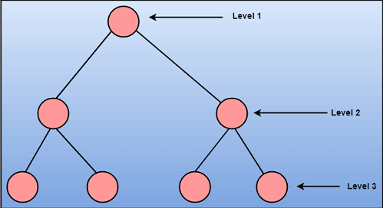
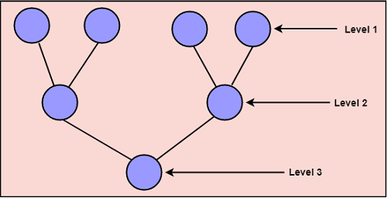
Top-down Approach: This approach starts with the identification of the main components and then decomposing them into their more detailed sub-components.
Bottom-up Approach: A bottom-up approach begins with the lower details and moves towards up the hierarchy, as shown in fig. This approach is suitable in case of an existing system.

Slide 18
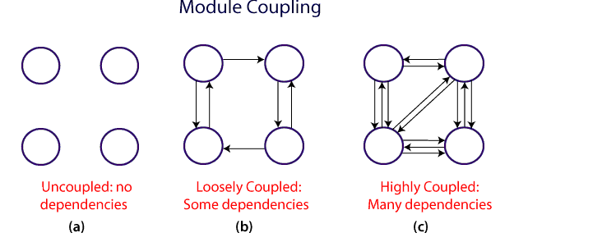
Coupling and Cohesion
Module Coupling
In software engineering, the coupling is the degree of interdependence between software modules.
Two modules that are tightly coupled are strongly dependent on each other. However, two modules that are loosely coupled are not dependent on each other.
Uncoupled modules have no interdependence at all within them.
The various types of coupling techniques are shown in fig

Slide 19
A good design is the one that has low coupling. Coupling is measured by the number of relations between the modules.
That is, the coupling increases as the number of calls between modules increase or the amount of shared data is large.
Thus, it can be said that a design with high coupling will have more errors.

Slide 20
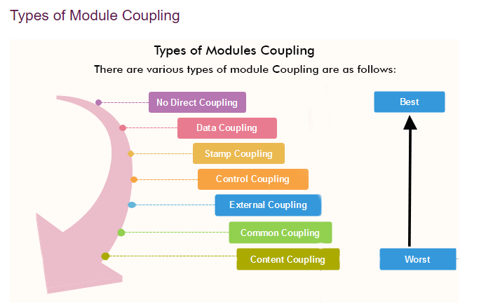

Slide 21
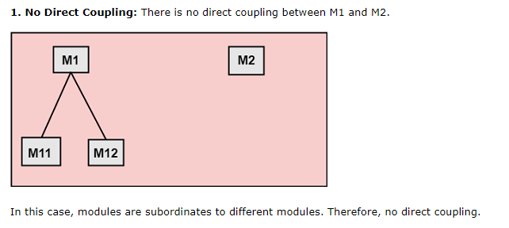
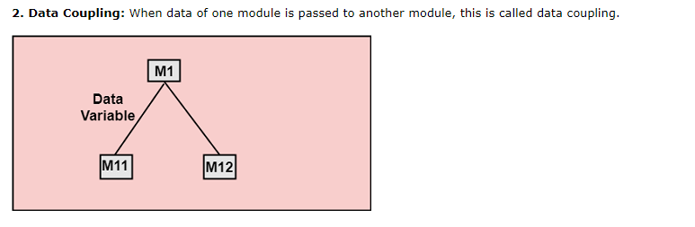

Slide 22
Stamp Coupling:
Two modules are stamp coupled if they communicate using composite data items such as structure, objects, etc.
When the module passes non-global data structure or entire structure to another module, they are said to be stamp coupled.
For example, passing structure variable in C or object in C++ language to a module.
Control Coupling:
Control Coupling exists among two modules if data from one module is used to direct the structure of instruction execution in another.

Slide 23
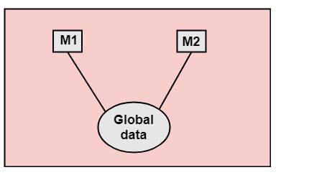
External Coupling
External Coupling arises when two modules share an externally imposed data format, communication protocols, or device interface.
This is related to communication to external tools and devices.
Common Coupling:
Two modules are common coupled if they share information through some global data items.
Content Coupling: Content Coupling exists among two modules if they share code, e.g., a branch from one module into another module.

Slide 24
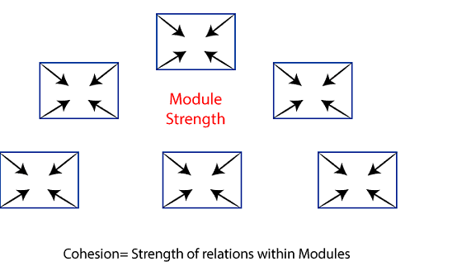
Module Cohesion
In computer programming, cohesion defines to the degree to which the elements of a module belong together.
Thus, cohesion measures the strength of relationships between pieces of functionality within a given module.
For example, in highly cohesive systems, functionality is strongly related.
Cohesion is an ordinal type of measurement and is generally described as "high cohesion" or "low cohesion."

Slide 25
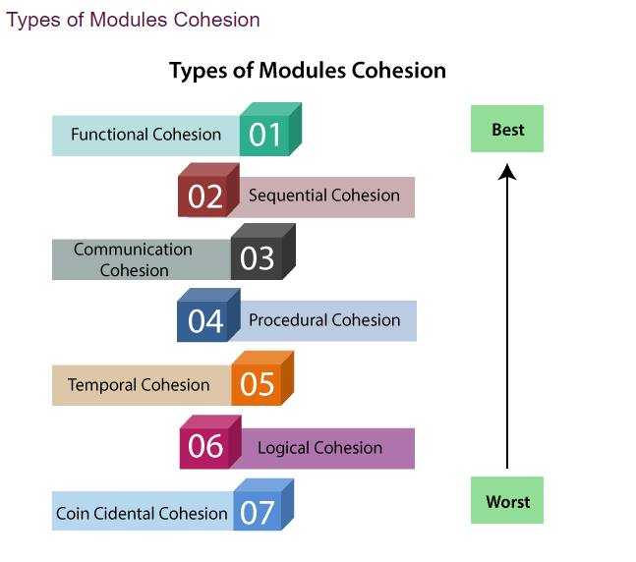

Slide 26
Functional Cohesion: Functional Cohesion is said to exist if the different elements of a module, cooperate to achieve a single function.
Sequential Cohesion: A module is said to possess sequential cohesion if the element of a module form the components of the sequence, where the output from one component of the sequence is input to the next.
Communicational Cohesion: A module is said to have communicational cohesion, if all tasks of the module refer to or update the same data structure, e.g., the set of functions defined on an array or a stack.
Procedural Cohesion: A module is said to be procedural cohesion if the set of purpose of the module are all parts of a procedure in which particular sequence of steps has to be carried out for achieving a goal, e.g., the algorithm for decoding a message.

Slide 27
Temporal Cohesion: When a module includes functions that are associated by the fact that all the methods must be executed in the same time, the module is said to exhibit temporal cohesion.
Logical Cohesion: A module is said to be logically cohesive if all the elements of the module perform a similar operation. For example Error handling, data input and data output, etc.
Coincidental Cohesion: A module is said to have coincidental cohesion if it performs a set of tasks that are associated with each other very loosely, if at all

Slide 28
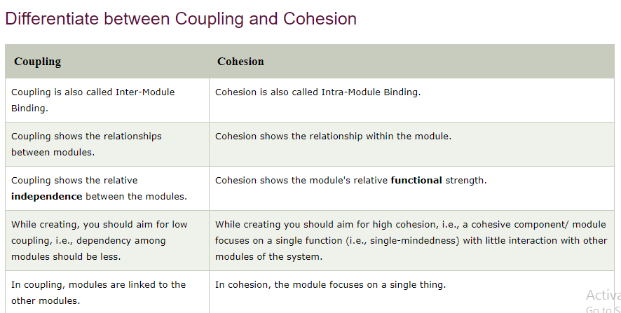

Slide 29
Design Heuristics
Heuristics are powerful tools in designing software and they provide a more subjective view of software quality.
Application of heuristics is a difficult task and this potentially places a greater burden on the developers who must interpret this view
Heuristics may occur as individual pieces of developers’ or as a suite covering multiple aspects of software development
Heuristics are an important part of software design and are becoming more widely used.
Effective visualization of heuristics includes quantitative, qualitative and ambient aspects.

Slide 30
Visualization of heuristics provides many challenges.
Heuristics are likely to be studied both individually and in comparison with others.
Function Oriented Design
Function Oriented design is a method to software design where the model is decomposed into a set of interacting units or modules where each unit or module has a clearly defined function.
Thus, the system is designed from a functional viewpoint.
Design Notations
Design Notations are primarily meant to be used during the process of design and are used to represent design or design decisions.
For a function-oriented design, the design can be represented graphically or mathematically by the following:

Slide 31
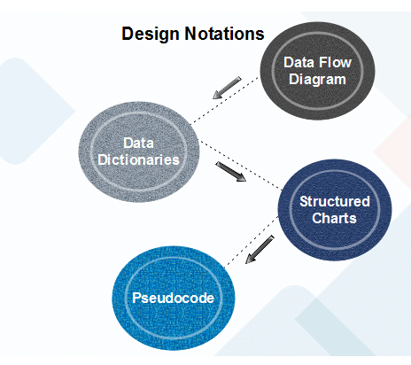

Slide 32
Data Flow Diagram
Data-flow design is concerned with designing a series of functional transformations that convert system inputs into the required outputs.
The design is described as data-flow diagrams.
These diagrams show how data flows through a system and how the output is derived from the input through a series of functional transformations.
Data-flow diagrams are a useful and intuitive way of describing a system.
They are generally understandable without specialized training, notably if control information is excluded.

Slide 33
They show end-to-end processing.
That is the flow of processing from when data enters the system to where it leaves the system can be traced.
Data-flow design is an integral part of several design methods, and most CASE tools support data-flow diagram creation.
Different ways may use different icons to represent data-flow diagram entities, but their meanings are similar.

Slide 34
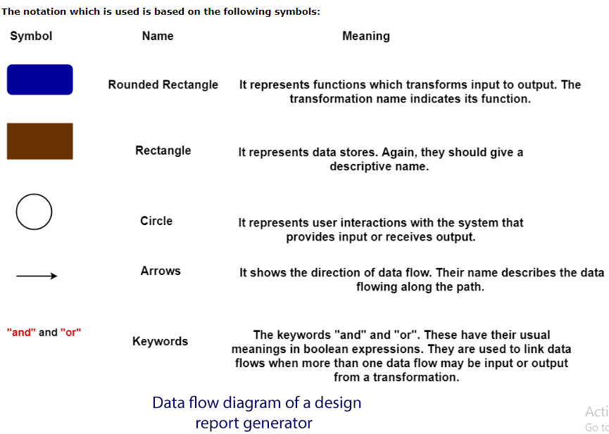

Slide 35
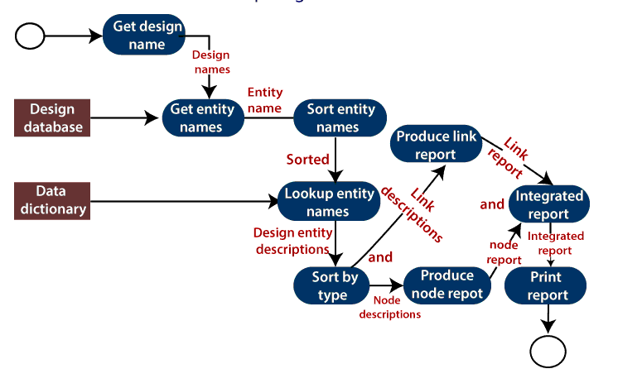

Slide 36
The report generator produces a report which describes all of the named entities in a data-flow diagram.
The user inputs the name of the design represented by the diagram.
The report generator then finds all the names used in the data-flow diagram.
It looks up a data dictionary and retrieves information about each name.
This is then collated into a report which is output by the system.

Slide 37
Object-Oriented Design
In the object-oriented design method, the system is viewed as a collection of objects (i.e., entities).
The state is distributed among the objects, and each object handles its state data. For example, in a Library Automation Software, each library representative may be a separate object with its data and functions to operate on these data.
The tasks defined for one purpose cannot refer or change data of other objects.
Objects have their internal data which represent their state. Similar objects create a class.
In other words, each object is a member of some class. Classes may inherit features from the superclass.

Slide 38
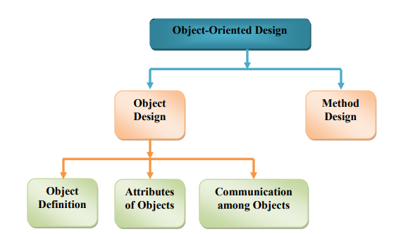

Slide 39
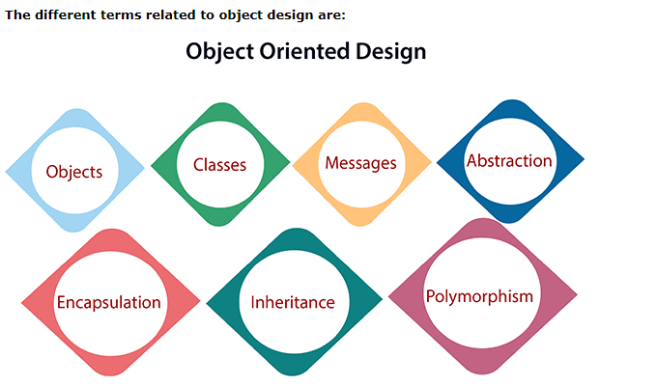

Slide 40
Objects: All entities involved in the solution design are known as objects. For example, person, banks, company, and users are considered as objects. Every entity has some attributes associated with it and has some methods to perform on the attributes.
Classes: A class is a generalized description of an object. An object is an instance of a class. A class defines all the attributes, which an object can have and methods, which represents the functionality of the object.
Messages: Objects communicate by message passing. Messages consist of the integrity of the target object, the name of the requested operation, and any other action needed to perform the function. Messages are often implemented as procedure or function calls.
Abstraction In object-oriented design, complexity is handled using abstraction. Abstraction is the removal of the irrelevant and the amplification of the essentials.

Slide 41
Encapsulation: Encapsulation is also called an information hiding concept. The data and operations are linked to a single unit. Encapsulation not only bundles essential information of an object together but also restricts access to the data and methods from the outside world.
Inheritance: OOD allows similar classes to stack up in a hierarchical manner where the lower or sub-classes can import, implement, and re-use allowed variables and functions from their immediate superclasses.This property of OOD is called an inheritance. This makes it easier to define a specific class and to create generalized classes from specific ones.
Polymorphism: OOD languages provide a mechanism where methods performing similar tasks but vary in arguments, can be assigned the same name. This is known as polymorphism, which allows a single interface is performing functions for different types. Depending upon how the service is invoked, the respective portion of the code gets executed.

Slide 42
Heuristics for Object Oriented Design
Design evaluation is effective and beneficial to both expert and novice designers during software development process.
Design heuristics are proposed as a more accessible and informal means by which developers can evaluate OO design.
Software heuristics are small, simple, legible, self-contained nuggets of design expertise.
They target specific design problems and provide guidance to affect a solution.
Unlike metrics, heuristics are outwardly defined in terms of the observable problems that occur during OOD.

Slide 43
Design Model and Document
A design model in Software Engineering is an object-based picture or pictures that represent the use cases for a system.
Or to put it another way, it is the means to describe a system's implementation and source code in a diagrammatic fashion.
This type of representation has a couple of advantages.
First, it is a simpler representation than words alone.
Second, a group of people can look at these simple diagrams and quickly get the general idea behind a system.
In the end, it boils down to the old adage, 'a picture is worth a thousand words.

Slide 44
Design Documentation:
Design documentation is a collection of documents and resources that covers all aspects of your product design.
Documentation should include information about users, product features, and project deadlines; all essential implementation details; and design decisions that your team and stakeholders have agreed on.
Investing In Documentation Design:
Clarify project requirements
Gaining stakeholder approval to begin implementing a design is one of the most important steps in the design process.
You need to be on the same page with stakeholders to gain this approval.
Proper documentation makes it easier to achieve this goal.

Slide 45
Streamline design implementation
By documenting a design, you also aid in the implementation of it.
Product design is a collaborative process, and in many cases, multiple people work on the project.
It’s not always possible to share implementation details verbally (for example, when you work with remote teams).
Thus, the design documents act as a single source of truth for everyone who is involved in product development and can rally your team around a specific goal.

Slide 46
Motivate your team
Good documentation tells a high-level story about the product and gets team members excited about the vision.
It answers the questions, “How do we want to build this?” and, importantly, “Why do we want to build this?”
A list of essential docs
While documentation can vary from project to project, the following docs will be relevant to all.
This information can be included in a single document or separated into multiple documents. Which approach you take will depend on the complexity of your project.
Project overview – This document contains a high-level overview of the design and the goals the design team wants to accomplish. By reading this document, anyone should be able to understand the purpose of a project.

Slide 47
Product requirements
This document covers the business and technical requirements of the design.
It should be shared with stakeholders before starting the design to ensure that both types of requirements are satisfied.
It’s also worth including in this doc information about constraints and assumptions because they will influence the design decisions.
Project deliverables
This document provides information about the design artifacts established during the wireframing and prototyping phases (e.g., lo-fi wireframes, mock-ups, hi-fi prototypes) that will be provided as deliverables once implementation has been completed.

Slide 48
Target audience information
This document lists relevant information about your audience, from user personas to data from user research.
This information will help your team understand who your users are and what good design means to them (via their functional and aesthetic preferences).
The doc serves as a reference for designers when sharing their rationale behind individual design decisions.
User journeys
This document outlines the path a user may take to reach their goal when using a product.

Slide 49
Design guidelines
This document describes the components and specifications required to build the solution.
Style guides
This document lists a set of standards for the stylization of design.
Styles, colors, and typefaces are essential pieces of this guide.
Project scope and implementation plan
This document describes the roles and flow of cross-team collaboration.
The implementation plan documents the requirements necessary to complete the implementation of the design.
For simple projects, it might be a high-level overview of the steps required to complete the implementation.
For complex projects, it can include a project timeline with information about the time required to complete each of the steps.

Slide 50
Design validation and user testing
This document provides an overview of the practices to be executed during the product design cycle, as well as steps to be taken after product release to verify that the product satisfies user needs.
Operational instructions
This document provides detailed instructions on how to perform common operational tasks after the design is implemented.
For example, it can provide step-by-step instructions on how to roll out a new version of an app in the production environment.

Slide 51
Properly documenting design
Though there’s no single way to conduct design documentation, and it varies by product team, there are a few general recommendations that can benefit every project.
Make documentation usable for the target audience
It’s possible to identify three large groups of users for documentation: product team members, stakeholders, and end users.
Every group has its own needs, and it’s important to consider this fact when working on your docs.
Both the content of and the format for documentation should be adapted to suit your target audience.
Provide up-to-date documentation
Introduce a version control framework to keep your documentation up-to-date and therefore minimize the risk of incorrect design decisions

Slide 52
Work on design documentation incrementally
Documentation design isn’t a one-and-done activity.
In many cases, it’s impossible to create all the docs in one attempt.
Thus, product teams should work on documentation as they go through the project.
Documentation should be a “living” project that is constantly updated as you work on the design.
Product teams should invest time in creating a flexible, accessible structure anyone from a team should be able to update documentation rather effortlessly.

Slide 53
Test documentation
Documentation is a by-product of your product design, and like other products, it should be tested with users.
Ensure that users know how to use it and find the documentation valuable.
You can also introduce a simple feedback loop, such as an online response form, so your users can record their reactions and help you continuously improve your documentation.
Conclusion
Creating design documentation is an important step in the project design process and has a direct impact on the outcome.
The best design documentation gives a product team a framework for making design decisions.
No matter how tight your deadlines for creating a design, you should never overlook the documentation process.

Slide 54
Architecture Design
Requirements of the software should be transformed into an architecture that describes the software's top-level structure and identifies its components.
This is accomplished through architectural design (also called system design), which acts as a preliminary 'blueprint' from which software can be developed.
architectural design defines as 'the process of defining a collection of hardware and software components and their interfaces to establish the framework for the development of a computer system.
This framework is established by examining the software requirements document and designing a model for providing implementation details.
These details are used to specify the components of the system along with their inputs, outputs, functions, and the interaction between them.

Slide 55
An architectural design performs the following functions.
It defines an abstraction level at which the designers can specify the functional and performance behaviour of the system.
It acts as a guideline for enhancing the system (when ever required) by describing those features of the system that can be modified easily without affecting the system integrity.
It evaluates all top-level designs.
It develops and documents top-level design for the external and internal interfaces.
It develops preliminary versions of user documentation

Slide 56
It defines and documents preliminary test requirements and the schedule for software integration.
Information regarding the application domain for the software to be developed
Using data-flow diagrams
Availability of architectural patterns and architectural styles.

Slide 57
Architectural design is of crucial importance in software engineering during which the essential requirements like reliability, cost, and performance are dealt with.
This task is cumbersome as the software engineering paradigm is shifting from monolithic, stand-alone, built-from-scratch systems to componentized, evolvable, standards-based, and product line-oriented systems.
Also, a key challenge for designers is to know precisely how to proceed from requirements to architectural design.
To avoid these problems, designers adopt strategies such as reusability, componentization, platform-based, standards-based, and so on.
Though the architectural design is the responsibility of developers, some other people like user representatives, systems engineers, hardware engineers, and operations personnel are also involved.

Slide 58
All these stakeholders must also be consulted while reviewing the architectural design in order to minimize the risks and errors
Architectural Design Representation
Architectural design can be represented using the following models.
Structural model: Illustrates architecture as an ordered collection of program components
Dynamic model: Specifies the behavioral aspect of the software architecture and indicates how the structure or system configuration changes as the function changes due to change in the external environment
Process model: Focuses on the design of the business or technical process, which must be implemented in the system
Functional model: Represents the functional hierarchy of a system
Framework model: Attempts to identify repeatable architectural design patterns encountered in similar types of application. This leads to an increase in the level of abstraction.

Slide 59
Architectural Design Output
The architectural design process results in an Architectural Design Document (ADD).
This document consists of a number of graphical representations that comprises software models along with associated descriptive text.
The software models include static model, interface model, relationship model, and dynamic process model.
They show how the system is organized into a process at run-time.
Architectural design document gives the developers a solution to the problem stated in the Software Requirements Specification (SRS).
Note that it considers only those requirements in detail that affect the program structure. In addition to ADD, other outputs of the architectural design are listed below.

Slide 60
Various reports including audit report, progress report, and configuration status accounts report
Various plans for detailed design phase, which include the following
Software verification and validation plan
Software configuration management plan
Software quality assurance plan
Software project management plan.

Slide 61
Software Architecture
The software architecture of a program or computing system is a depiction of the system that aids in understanding how the system will behave.
Software architecture serves as the blueprint for both the system and the project developing it, defining the work assignments that must be carried out by design and implementation teams.
The architecture is the primary carrier of system qualities such as performance, modifiability, and security, none of which can be achieved without a unifying architectural vision.
Architecture is an artifact for early analysis to make sure that a design approach will yield an acceptable system.
By building an effective architecture, you can identify design risks and mitigate them early in the development process

Slide 62
Need of Architecture :
The architecture is not the operational software. Rather, it is a representation that enables a software engineer to:
(1) analyze the effectiveness of the design in meeting its stated requirements,
(2) consider architectural alternatives at a stage when making design changes is still relatively easy, and
(3) reduce the risks associated with the construction of the software.

Slide 63
Methods for Software Architecture:
Capture architecturally significant requirements by analyzing the business drivers, system context, and factors that system stakeholders deem critical to success. We use two methods to identify important nonfunctional quality attributes of the system (e.g., performance, dependability, security, safety) and clarify system requirements.
Design an architecture by developing architectural structures and coordination strategies that satisfy requirements
Evaluate the architecture by determining its ability to support the quality attributes that meet an organization's business and mission goals.
Document the architecture in sufficient detail and in an easily accessible form to facilitate communication with developers and other stakeholders and to support analysis.

Slide 64
Data Design
Data design is the first design activity, which results in less complex, modular and efficient program structure.
The information domain model developed during analysis phase is transformed into data structures needed for implementing the software.
The data objects, attributes, and relationships depicted in entity relationship diagrams and the information stored in data dictionary provide a base for data design activity.
During the data design process, data types are specified along with the integrity rules required for the data. For specifying and designing efficient data structures, some principles should be followed.

Slide 65
The data structures needed for implementing the software as well-as the operations that can be applied on them should be identified.
A data dictionary should be developed to depict how different data objects interact with each other and what constraints are to be imposed on the elements of data structure.
Stepwise refinement should be used in data design process and detailed design decisions should be made later in the process.
Only those modules that need to access data stored in a data structure directly should be aware of the representation of the data structure.
A library containing the set of useful data structures along with the operations that can be performed on them should be maintained.
Language used for developing the system should support abstract data types

Slide 66
The structure of data can be viewed at three levels, namely, program component level, application level, and business level.
At the program component level, the design of data structures and the algorithms required to manipulate them is necessary, if high-quality software is desired.
At the application level, it is crucial to convert the data model into a database. so that the specific business objectives of a system could be achieved
.At the business level, the collection of information stored in different databases should be reorganized into data warehouse, which enables data mining that has an influential impact on the business.

Slide 67
Transform and Transaction Mapping
Transform Mapping (Analysis)
A structure chart is produced by the conversion of a DFD diagram; this conversion is described as ‘transform mapping (analysis)’.
It is applied through the ‘transforming’ of input data flow into output data flow.
Transform analysis establishes the modules of the system, also known as the primary functional components, as well as the inputs and outputs of the identified modules in the DFD.
Transform analysis is made up of a number of steps that need to be carried out. The first one is the dividing of the DFD into 3 parts:
Input
Logical processing
Output

Slide 68
The ‘input’ part of the DFD covers operations that change high level input data from physical to logical form e.g. from a keyboard input to storing the characters typed into a database. Each individual instance of an input s called an ‘afferent branch’.
The ‘output’ part of the DFD is similar to the ‘input’ part in that it acts as a conversion process. However, the conversion is concerned with the logical output of the system into a physical one e.g. text stored in a database converted into a printed version through a printer. Also, similar to the ‘input’, each individual instance of an output is called as ‘efferent branch’. The remaining part of a DFD is called the central transform.

Slide 69
Transform analysis is a set of design steps that allows a DFD with transform flow characteristics to be mapped into specific architectural style. These steps are as follows:
Step1: Review the fundamental system model
Step2: Review and refine DFD for the SW
Step3: Assess the DFD in order to decide the usage of transform or transaction flow.
Step4: Identify incoming and outgoing boundaries in order to establish the transform center.
Step5: Perform "first-level factoring".
Step6: Perform "second-level factoring".
Step7: Refine the first-iteration architecture using design heuristics for improved SW quality.

Slide 70
Transaction Mapping (Analysis)
Similar to ‘transform mapping’, transaction analysis makes use of DFDs diagrams to establish the various transactions involved and producing a structure chart as a result.
Transaction mapping Steps:
Review the fundamental system model
Review and refine DFD for the SW
Assess the DFD in order to decide the usage of transform or transaction flow.
Identify the transaction center and the flow characteristics along each action path
Find transaction center
Identify incoming path and isolate action paths
Evaluate each action path for transform vs. transaction characteristics

Slide 71
Map the DFD in a program structure agreeable to transaction processing
Carry out the ‘factoring’ process
Refine the first iteration program/ architecture using design heuristics for improved SW quality
In transaction mapping a single data item triggers one of a number of information flows that affect a function implied by the triggering data item. The data item implies a transaction.

Slide 72
User Interface Design
The visual part of a computer application or operating system through which a client interacts with a computer or software.
It determines how commands are given to the computer or the program and how data is displayed on the screen.
Types of User Interface
There are two main types of User Interface:
Text-Based User Interface or Command Line Interface
Graphical User Interface (GUI)

Slide 73
Text-Based User Interface: This method relies primarily on the keyboard. A typical example of this is UNIX.
Advantages
Many and easier to customizations options.
Typically capable of more important tasks.
Disadvantages
Relies heavily on recall rather than recognition.
Navigation is often more difficult.

Slide 74
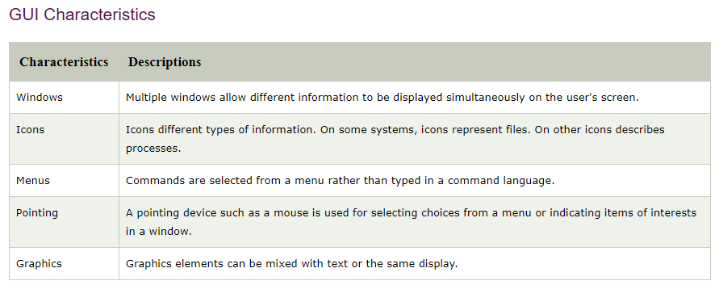
Graphical User Interface (GUI):
GUI relies much more heavily on the mouse.
A typical example of this type of interface is any versions of the Windows operating systems.

Slide 75
Advantages
Less expert knowledge is required to use it.
Easier to Navigate and can look through folders quickly in a guess and check manner.
The user may switch quickly from one task to another and can interact with several different applications.
Disadvantages
Typically decreased options.
Usually less customizable. Not easy to use one button for tons of different variations.

Slide 76
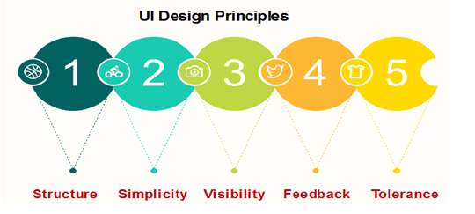
UI Design Principles

Slide 77
Structure:
Design should organize the user interface purposefully, in the meaningful and usual based on precise, consistent models that are apparent and recognizable to users, putting related things together and separating unrelated things, differentiating dissimilar things and making similar things resemble one another.
The structure principle is concerned with overall user interface architecture.
Simplicity:
The design should make the simple, common task easy, communicating clearly and directly in the user's language, and providing good shortcuts that are meaningfully related to longer procedures

Slide 78
Visibility:
The design should make all required options and materials for a given function visible without distracting the user with extraneous or redundant data.
Feedback:
The design should keep users informed of actions or interpretation, changes of state or condition, and bugs or exceptions that are relevant and of interest to the user through clear, concise, and unambiguous language familiar to users.
Tolerance:
The design should be flexible and tolerant, decreasing the cost of errors and misuse by allowing undoing and redoing while also preventing bugs wherever possible by tolerating varied inputs and sequences and by interpreting all reasonable actions

